Slide 1



Data-Semantics-Aware
Recommendation of Diverse Pivot Tables
Whanhee Cho, Anna Fariha
University of Utah
ACM SIGMOD/PODS International Conference on Management of Data
2026
Notes:
Hi I’m Whanhee from the University of Utah, advised by Anna Fariha.
Today I’m going to present our work
on recommending data summaries in the form of *PIVOT TABLES* in spreadsheets.

Slide 2



Spreadsheets user base is growing...
Spreadsheets were initially meant for small, simple tables
700 million to 1 billion people use spreadsheets daily!
Notes:
You don't need a huge database for everything.
Spreadsheets are perfect for *small, simple tables*
and that’s exactly why a *billion* people use them daily.

Slide 3

Spreadsheets data size is also growing!
Microsoft Excel allows up to 1M rows & 16K columns
Million Rows
16K columns
16K rows
How to analyze massive data in spreadsheets?
[1] Microsoft Excel Workbook Files, SAS Help Center
Notes:
BUT here’s the thing: spreadsheets aren’t small anymore
We’ve gone from 16Ktuples in the 90s to over a million tuples today.
This is not small data.
(click for animation)
And doing manual analysis on this scale is just a nightmare.

Slide 4
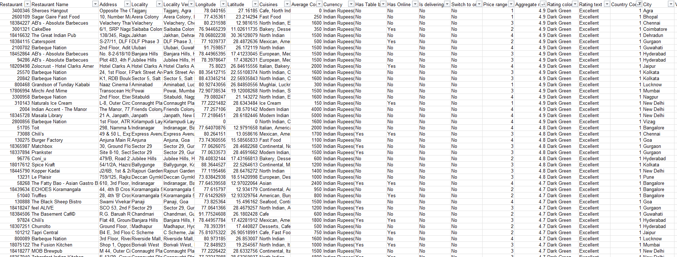
We need data summaries
[Data Summaries]
Data summaries can help understand the data quickly
Visualization
SeeDB [VLDB 2015]
20 Attributes
Interactive Exploration
Smart Drill-Down [ICDE 2016]
Summary Tables
Pivot Tables in Spreadsheets
Aggregate SQL Queries in RDBMS
Restaurant Data
10K Tuples
Notes:
So, what’s the fix? data summaries.
No one is manually analyzing this big dataset,
So,
We need a way to shrink that data down,
and data summaries can do that.
<CLICK>
Data summaries can be visualization, interactive exploration, or summary tables.
<CLICK>
For thius work, we are focusing specifically on one type of summary table: pivot tables in spreadsheets.

Slide 5
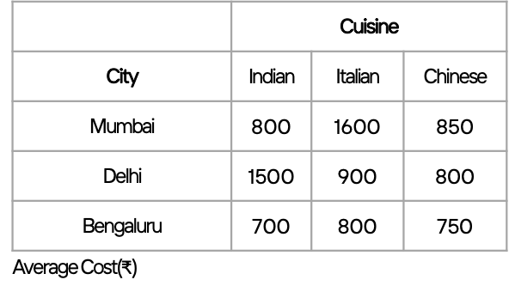
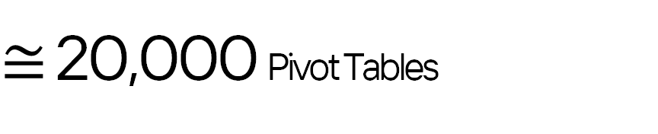
Too slow to check every summary manually!
20,000 pivot tables to manually create and check
Average
Cost(₹)
By
and
Cuisine
City
5 aggregations
20 values
X
171 Pairs
$≅$ 20,000 Pivot Tables
X
We need pivot table recommendation!
Notes:
But here's the problem
manually creating and checking every single pivot table?
It takes too much time.
//In our example alone, there are about 20,000 possible tables.
//Who has the time for that?
(click)
This is exactly why we need pivot table recommendation.

Slide 6
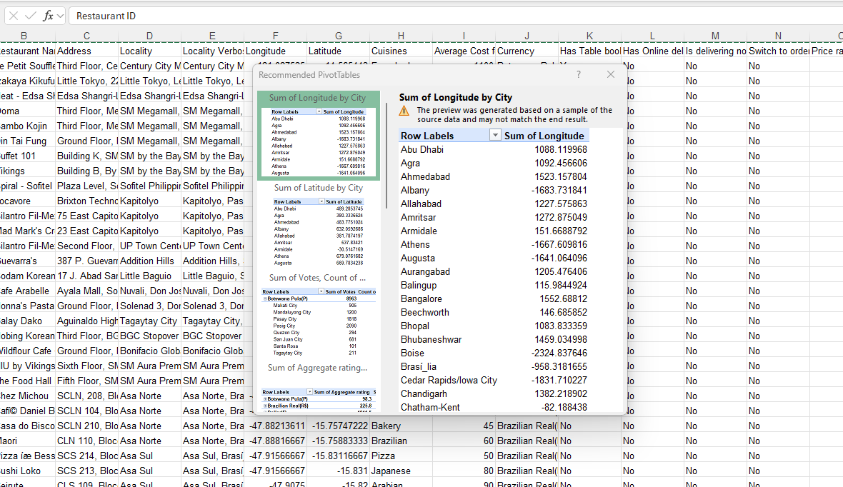
Commercial Spreadsheets suggest Pivot Tables, but…
Recommended SET of pivot tables
Notes:
Tools like Excel or Google Sheets can already suggest pivot tables.
They're pretty handy, but there are a few big problems…
they look okay at first, but let’s look a little closer…

Slide 7
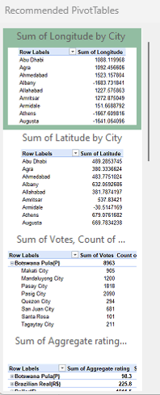
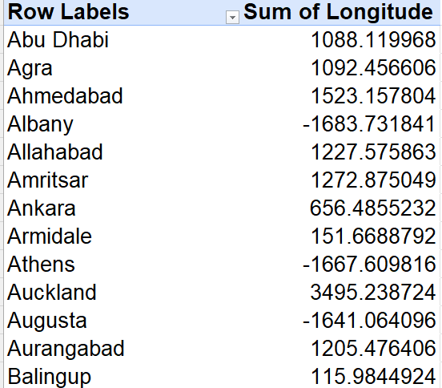
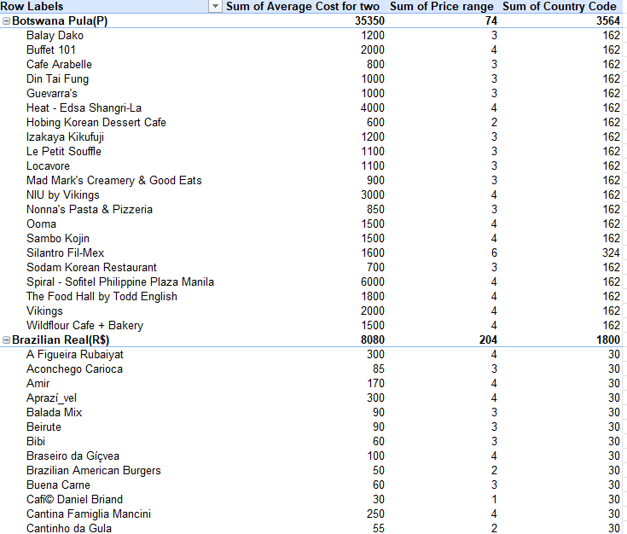
Are they any good?
Sum of Longitude by City
Notes:
The first suggested pivot table...
(click)

Slide 8

Unaware of Data Semantics
SUM(Longitude) GROUP BY City
Sum of Longitude by City
SUM of Longitude doesn’t make any sense!
Notes:
.. is summing over longitude by city!”
But “Sum of Longitude”,
(click) doesn’t make any sense!
We need meaning in the pivot table, not just math.

Slide 9
Are they any good?
Sum of Longitude by City
Sum of Longitude by City
Sum of Aggregate rating…
Notes:
Let's see another one ...

Slide 10
Cognitive Overload!
SUM(COST), SUM(Price Range), SUM(COUNTRY CODE) GROUP BY Restaurant Name, Currency
Sum of Longitude by City
Too Big!
We wanted a SUMMARY
Sum of Aggregate rating…
Notes:
Well while this table makes sense, it is just too big.
(click!)
An analyst will probably feel overloaded with this suggestion.
So again, this is not good either.

Slide 11
What makes a pivot table worthy to recommend?
It should give INSIGHT about the data
Similar colors=Similar values
💡
 | Cuisine
City | Indian | Italian | Chinese
Agra | 4.5 | 4.7 | 4.4
Kanpur | 4.3 | 4.6 | 4.5
Bengaluru | 4.6 | 4.7 | 4.6
 | Cuisine
City | Indian | Italian | Chinese
Agra | 300 | 1200 | 700
Kanpur | 200 | 1300 | 900
Bengaluru | 250 | 1750 | 500
Insightful!
Average Rating
Average Cost (₹)
Uniform values
are not insightful
Varied values are insightful!
Notes:
So how do we define a good recommendation?
(click)
A table like this, where all the numbers are pretty much the same, is not insightful.
(click)
But this one?
You can see huge differences! You can see Italian is the most expensive.
This tells us, pivot tables where the numbers really jump around are good and way more interesting.

Slide 12
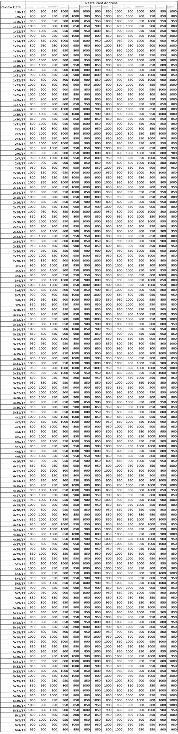
What makes a pivot table worthy to recommend?
It should be easy to INTERPRET by humans
 | Cuisine
City | Indian | Italian | Chinese
Agra | 300 | 1200 | 700
Kanpur | 200 | 1300 | 900
Bengaluru | 250 | 1750 | 500
Interpretable!
Average Cost (₹)
Big tables are
hard to interpret
Smaller tables are easy to interpret
Notes:
The second thing we need is for the table to be easy to read at a glance.
(click!)
look at this table.
It’s introducing the review date from 2017, but it’s too big
Nobody wants to look at that.
(click!)
But this table is way smaller.
It’s much easier to understand instantly.

Slide 13
Just one pivot table misses many data aspects
 | Cuisine
City | Indian | Italian | Chinese
Mumbai | 300 | 1200 | 700
Delhi | 200 | 1300 | 900
Bengaluru | 250 | 1750 | 500
Small numbers of attributes cannot cover various aspects of a big dataset
We need more attributes!
Average Cost (₹)
Notes:
So we know what makes one table good.
But with massive datasets, one suggestion barely scratches the surface.
(click)
The fix? Well, we add more attributes to cover more ground.

Slide 14
Large pivot tables are not easy to ingest
 |  | Cuisine
 |  | Indian |  |  | Italian |  |  | Chinese
 |  | Rating
City | Region | Excellent | Average | Poor | Excellent | Average | Poor | Excellent | Average | Poor
Mumbai | South Mumbai
 | Western Suburbs
 | Central Mumbai
 | Navi Mumbai
… | … | …
Add dimensions:
Rating, Region
Add dimensions:
Rating, Region
We need a SET of
SMALL pivot tables
Average Cost (₹)
One BIG pivot table causes cognitive overload!
Notes:
Here the table has more attributes, region and rating text.
(click)
But, as you can see, the table becomes too big to understand.
(click)
So, rather than adding more attributes,
We need A SET of pivot tables

Slide 15
Top-k recommendations are redundant
Top-K recommendations
overlap too much!
Top-3 Pivot Table Recommendations
Average Cost
group by
Cuisine
Average Cost
group by
Cuisine
and
Country
Average Cost
group by
Cuisine
and
City
We need a SET of
DIVERSE pivot tables
Notes:
So for a set, We can show the top-k results as a set of pivot tables like these.
(click)
But the top-k recommendations overlap too much in attributes.
(click)
So, ultimately, we need a set of diverse table.

Slide 16

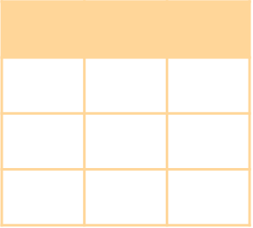

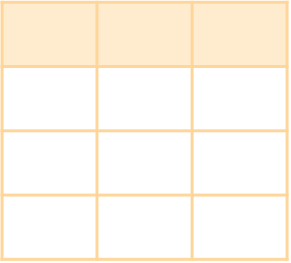


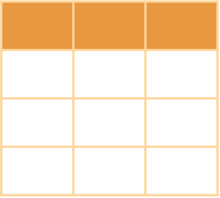

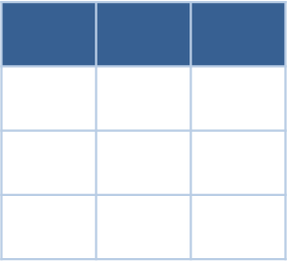
And then, what makes a SET of pivot tables good?
Search Space
Similar colors mean similar tables
Diversity!
Notes:
So, what makes a diverse set then?
If these colors represent similar tables, the ideal selection from search space looks like this
(click!) (click!) (click!)

Slide 17
Problem we address in this work
Recommend a set of diverse and good pivot tables
Notes:
Putting all these together,
our goal in this paper is to recommend pivot tables,

Slide 18

Problem we address in this work
Recommend a set of diverse and good pivot tables
User-Aware
Notes:
, which means it must be *aware* of the *user’s intents*

Slide 19
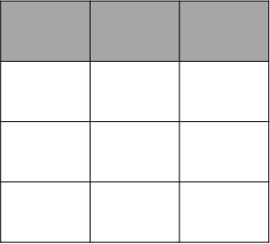
Problem we address in this work
Not just a top-k
Recommend a set of diverse and good pivot tables
User-Aware
Notes:
Make the recommendation in the form of
a SET of pivot tables, not just top-k,

Slide 20
Problem we address in this work
Not just a top-k
Recommend a set of diverse and good pivot tables
User-Aware
Reduce redundancy
Notes:
Also, we want the set of tables to be *diverse*,
,
while avoiding redundancy

Slide 21

Problem we address in this work
Each pivot table must be insightful and interpretable
Not just a top-k
Recommend a set of diverse and good pivot tables
User-Aware
Reduce redundancy
💡
💡
💡
Notes:
And finally, each of the recommended pivot tables must be “Good”,
that is <CLICK> insightful and <CLICK> interpretable.
So, to solve this problem...

Slide 22
SAGE
🧙‍♂️
Data-Semantics-Aware system
For RecommendinG
K-Budgeted DivErse Pivot Tables
Notes:
we introduce our system, SAGE,
A system recommends data-semantics-aware and diverse pivot tables.

Slide 23
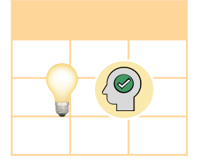

Challenges
How to quantify
diversity of a set of pivot tables?
How to quantify
goodness of a pivot table?
How to quantify
goodness of a pivot table?
How to make the recommendation real-time?
Notes:
we have addressed three challenges.
(click!)
First, we formally defined
what good pivot tables are
(click!)
Second, we modeled diversity among a set of pivot tables .
(click!)
Finally, we solved this in a realistic way..
(click)
First, let’s dive into the first one.

Slide 24
Utility of pivot tables via Insightfulness & Interpretability
Select important attributes
(Rating > Address)
Utility
Interpretability
Insightfulness
Attribute Significance
Trend
Informativeness
Outlier
Utility captures the goodness of a pivot table
Having high variablity among values
Having trends like correlation
How to quantify
goodness of a pivot table?
Notes:
First, we need to define what good pivot tables are.
Earlier, I mentioned the tables should be insightful and interpretable.
(click!)
Here, we model the utility of a table through both insightfulness and interpretability.

Slide 25
There are many signals for Insightfulness
Utility
Interpretability
Conciseness
Semantic Validity
Insightfulness
Attribute Significance
Trend
Density
Informativeness
Surprisingness
Utility captures the goodness of a pivot table
How to quantify
goodness of a pivot table?
Notes:
We worked on several types of them,

Slide 26
There are many signals for Insightfulness
Utility
Interpretability
Conciseness
Semantic Validity
Insightfulness
Attribute Significance
Trend
Density
Informativeness
Surprisingness
Utility captures the goodness of a pivot table
Discovers surprises
like outlier
How to quantify
goodness of a pivot table?
Notes:
But today, I’m going to show only one type: surprisingness.

Slide 27
Utility
Interpretability
Conciseness
Semantic Validity
Insightfulness
Attribute Significance
Trend
Density
Informativeness
Surprisingness
Surprisingness is not always insightful
Italian restaurant in Mumbai
is an outlier
 | Cuisine
City | Indian | Italian | Chinese
Mumbai | 800 | 1600 | 850
Delhi | 1500 | 900 | 800
Bengaluru | 700 | 800 | 750
Average Cost(₹)
Indian restaurant in Delhi
is also an outlier
Notes:
For being a good pivot table, the table would include unexpecting BIG value such as outliers,
In this table, you can see there are two outliers, Italian restaurant in Mumbai
and Indian restaurant in Delhi

Slide 28

Utility
Interpretability
Conciseness
Semantic Validity
Insightfulness
Attribute Significance
Trend
Density
Informativeness
Surprisingness
Surprisingness is not always insightful
Italian restaurant in Mumbai
is an outlier
SAGE semantically understands this
using LLMs
 | Cuisine
City | Indian | Italian | Chinese
Mumbai | 800 | 1600 | 850
Delhi | 1500 | 900 | 800
Bengaluru | 700 | 800 | 750
Expected in real-life = not insightful
High average cost Italian in Mumbai? Very likely!
Unexpected in real-life = insightful
Average Cost(₹)
LLM (Llama 3) estimates the likelihood
based on semantic understanding of the data.
Indian restaurant in Delhi
is also an outlier
Notes:
But are they really insightful?
High prices for Italian restaurants in Mumbai are expected as it’s a hub for fine dining.
But high prices for Indian food in Delhi?
This is unexpected in real-life
Five years ago, hard coding that real-world difference was nearly impossible.
Today?
(click!)
We just ask an LLM.
We let the LLM decide the likelihood of expectedness for such insights
so we can understand the semantic meaning behind the data.

Slide 29
Challenges
How to quantify
diversity of a set of pivot tables?
How to quantify
goodness of a pivot table?
How to quantify
goodness of a pivot table?
How to make the recommendation real-time?
Notes:
We’ve discussed about goodness of tables,
(click!)
Now let’s talk about the diversity for selecting a set of tables.

Slide 30
Diversity can be represented as maximizing the minimum distance
Semantically Close
Average Rating By Country
Average Cost(₹) By City And Cuisine
Average Cost(₹) By Country And Cuisine
Semantically Far
Notes:
Now, how do we get diversity?
Diversity can be represented as maximizing the minimum distance between tables
(click)
this table and
(click)
this table, they are similar.
(click)
So the distance between them should be close
(click)
But this table, is very different from the others.
(click)
So, the distance between this ta le and the others should be far.

Slide 31
Diverse Tables are Spatially Separated in Feature Space
[1, 2]
Map tables into a vector space and select distant tables for diversity
<Average Rating By Country>
: Different Query Semantics
Average Cost(₹) By City And Cuisine
Select pivot tables with
pair-wise large distance
for diversity
<Average Cost(₹) By Country And Cuisine>
: Similar Query Semantics
[1 ] Partial T5, a natural language encoder fined-tuned over a Text-to-SQL dataset for query embedding
[2] TAPEX, a pre-trained encoder trained on sentence-table pairs for content embedding
Notes:
Now, how do we measure the distance?
Imagine all tables are spread out on a vector space.
(click)
(click)
Semantically close tables would be close,
(click)
Semantically different tables would be far each other
(click)
By picking tables that are far apart on this space, we can provide a diverse set.

Slide 32
Challenges
How to quantify
diversity of a set of pivot tables?
How to quantify
goodness of a pivot table?
How to make the recommendation real-time?
Notes:
Now, finally, let’s discuss about real-time recommendation. (click)

Slide 33



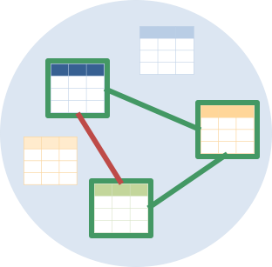
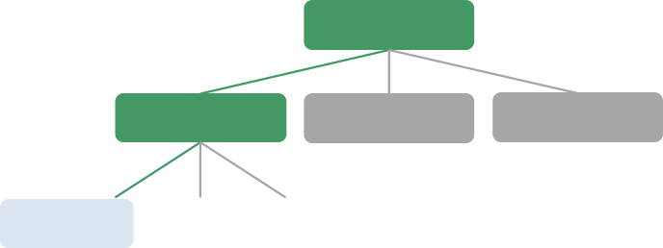
Enable real-time recommendation using 4 scaling methods
Prune low-quality tables
avoiding materialization
Sample tuples and tables for fast computation
Avoid using LLMs
in real-time,
train a LLM proxy
Greedily select tables by checking their
minimum distance
Notes:
So, we use four scaling methods to recommend pivot tables in real-time.
(click)
First, we prune low-quality tables to filter out low-quality candidates early and avoid materialization.
(click)
Second, we sample tuples and tables for fast computation.
(click)
we avoid using LLMs in real-time.
we train a LLM-proxy, decision tree.
(click)
and finally we greedily select tables rather than brute forcely select the best set

Slide 34
Experiment Settings
[Datasets]
Video Game
Video game sales, 11 attributes
Marketing
Customer information, 28 attributes
SAGE🧙‍♂️
[Configurations]
Recommend 5 diverse tables
Notes:
Let's see the actual experiment.
(click)
We input Video Games and Marketing datasets into SAGE.
(click)
For every recommendation, we set the system to suggest a set of 5 diverse tables
(click)
Then sage returns a set of tables

Slide 35


Human participants validated our notion of utility
Agreed on
Insightfulness
A vast majority of the participants agreed with our notion of utility.
SAGE outperformed all Baselines
[Evaluation Metrics]
💡
🧑‍💻
Runtime
Utility
Human Evaluation
There’s no benchmark for
table goodness
Agreed on
Interpretability
36 participants for user study
Notes:
(click)
To measure success, we evaluate the set based on three metrics:
Utility, Runtime, and Human Evaluation.
(click)
But is this 'Utility' the right measure?
Since there was no standard baseline for table evaluation,
we validated it ourselves with a 36-pariticpant user study.
(click)
The participants strongly validated our metric of insightfulness and interpretability.

Slide 36
Comparison between SAGE and baselines: Runtime & Utility
💡
🧑‍💻
Selects the best top-k utility pivot tables
SAGE
Top-k
LLM (LLaMa-3B)
Excel
LLM gets prompts and recommends pivot tables
Commercial Spreadsheet recommends pivot tables
Notes:
Now let’s move on to the evaluation.
First, we compared our recommendation runtime and utility against three baselines.
(click)
topk selects the best top-k pivot tables
llm returns pivot table recommendation
and microsoft excel recommends pivot tables

Slide 37
Finding 1: SAGE recommends pivot tables in real-time
SAGE achieves practically acceptable response time
 | Runtime (sec) | Utility | Diversity
SAGE | 17 | 2.36 | 0.23
Top-k | 64 | 2.67 | 0.05
LLM (LLaMa-3B) | 20 | 0.52 | 0.03
Excel | 1 | 1.80 | 0.04
Excel has the best response time
BEST
2nd BEST
Notes:
Now, how does SAGE runtime compare to others?
(clcik!)
In terms of runtime, Excel is the fastest, but SAGE is the second fastest.

Slide 38
💡
Finding 2: SAGE recommends high-utility pivot tables
BEST
2nd BEST
 | Runtime (sec) | Utility | Diversity
SAGE | 17 | 2.36 | 0.23
Top-k | 64 | 2.67 | 0.05
LLM (LLaMa-3B) | 20 | 0.52 | 0.03
Excel | 1 | 1.80 | 0.04
SAGE achieves
the second best utility
Excel’s recommendation has worse utility despite fast recommendation
Notes:
In terms of utility,
(click)
SAGE shows the second quality recommendations following top-k.
Excel showed good runtime earlier, but the utility was worse than ours.

Slide 39
💡
Finding 3: SAGE includes diverse pivot tables
SAGE achieves
the best diversity
 | Runtime (sec) | Utility | Diversity
SAGE | 17 | 2.36 | 0.23
Top-k | 64 | 2.67 | 0.05
LLM (LLaMa-3B) | 20 | 0.52 | 0.03
Excel | 1 | 1.80 | 0.04
BEST
2nd BEST
Top-k recommendations yield poor diversity as it maximizes utility
Notes:
(click)
For diversity, SAGE shows the best diversity

Slide 40

🧑‍💻
Real users preferred SAGE over other baselines
SAGE outperformed all baselines
36 participants for user study
Baselines: LLM & MS Excel
All the same
“SAGE provides more meaningful and helpful queries compared to the later two”
Preferred Excel
🧑‍💻
Preferred
SAGE
Preferred
LLM
Notes:
To test real-world usefulness, we ran a user study with 36 daily spreadsheet users,
comparing SAGE against Excel and LLMs results.
(clcik)
The majority of participants selected SAGE as the best recommendation tool.

Slide 41
Key Takeaways
SAGE provides Data-Semantics-Aware recommendations of pivot tables,
thanks to LLMs
SAGE recommends pivot tables in practically acceptable response-time
Real users preferred SAGE’s recommendations over other baselines
Notes:
In summary, SAGE recommends data-semantics-aware and diverse recommendation in real-time.

Slide 42
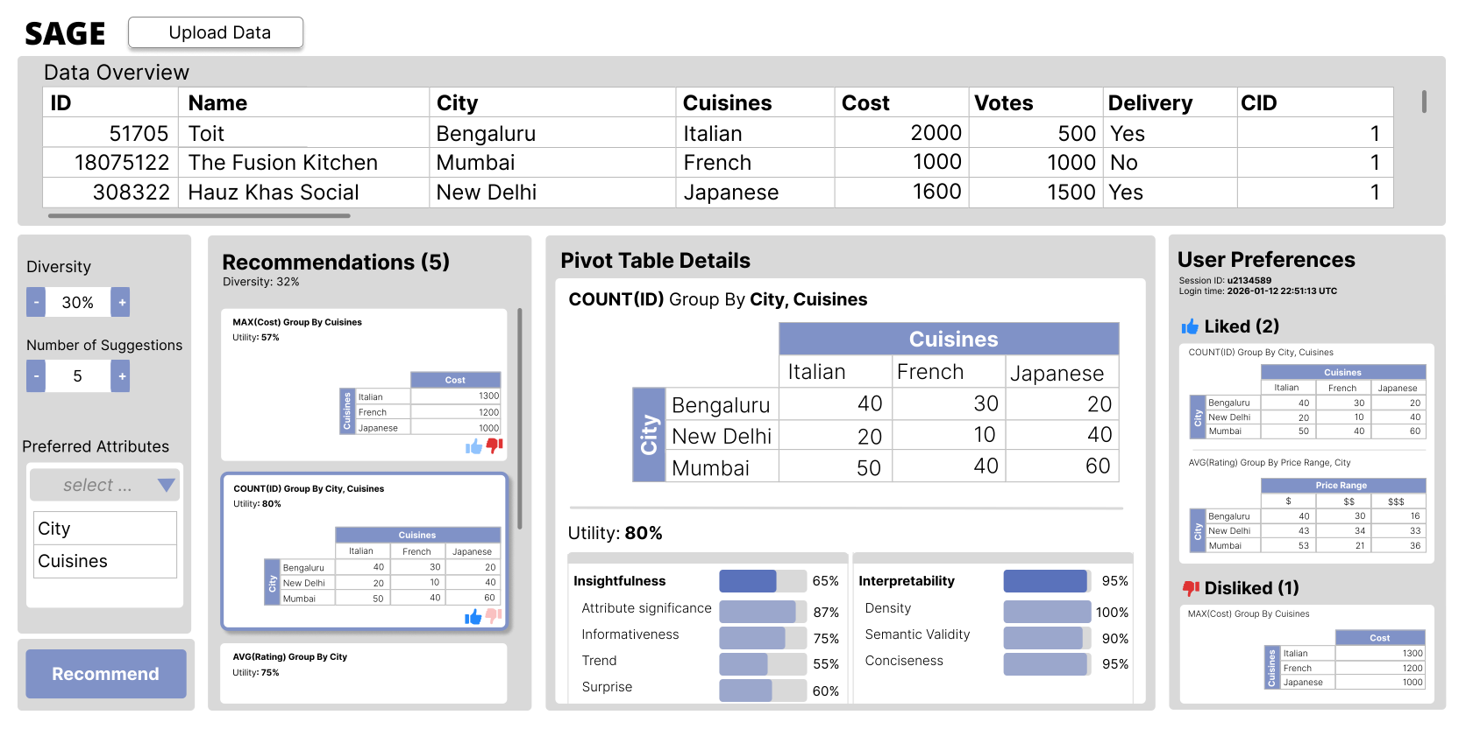

Questions?
Data-Semantics-Aware Recommendation of Diverse Pivot Tables
Whanhee Cho, Anna Fariha
Check our paper and code here!
Check our demo on Tue 3:30PM & Wed 1:30 PM
Notes:
Thank you and any questions?
---
please join the demo

